Slide 1
Recreational Boating Safety
Auxiliary Recreational Boating Safety Device

Slide 2
Our Mission
To promote and improve Recreational Boating Safety
To provide trained crews and facilities to augment the Coast Guard and enhance safety and security of our ports, waterways, and coastal regions
To support Coast Guard operational, administrative, and logistical Requirements

Slide 3
Need for RBS Activity
According to the 2013 Recreational Boating Statistics, what % of all drownings were attributed to paddle craft?
15%
25%
35%
45%

Slide 4
Need for RBS Activity
According to the 2013 Recreational Boating Statistics, what % of all drownings were attributed to paddle craft?
15%
25% (includes kayaks, canoes, paddle boards, row boats)
35%

Slide 5
US Coast Guard Auxiliary Strategic Plan 2014 – 2020
Expand and enhance efforts in water safety and education
Make the Auxiliary the key partner (i.e. USPS, ACA) in RBS efforts
Strengthen presence in electronic safe boating education (ebooks, on-line courses, new classroom material)

Slide 6
US Coast Guard Auxiliary Strategic Plan 2014 – 2020
Expand efforts in Water Safety = RBS Challenge
Increase Auxiliary presence and relevance in the growing paddle craft community to better promote on the water safety and reduce fatalities

Slide 7
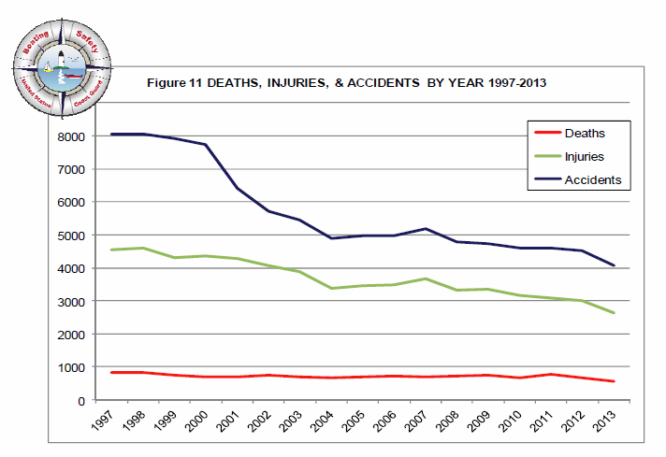
Recreational Boating Trends
Notes:
Deaths: 2011: 758, 2012: 651, 2013: 560

Slide 8
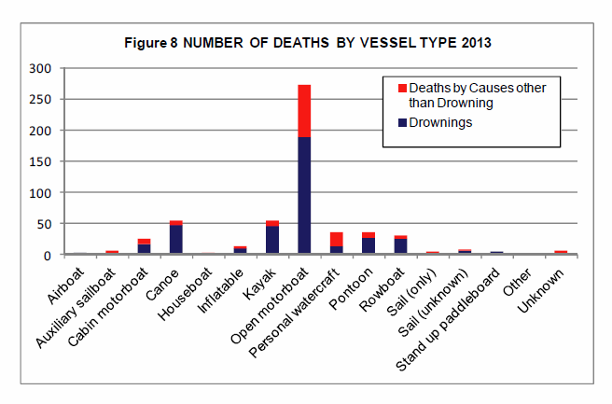
Recreational Boating Trends

Slide 9
Recreational Boating Trends
Common Characteristics - Boater Fatality:
Open motorboat
Between 55-59
No life jacket
Alcohol contributing factor
June/July, Saturday, between 2:30-4:30 PM
Good visibility
Vessel length =/< 16 feet

Slide 10
US Coast Guard Auxiliary Strategic Plan 2014 – 2020
Qualified Auxiliarists may support the RBS program by:
Conducting public education
Performing recreational Vessel Safety Checks (VSCs)
Participating in State Liaison Programs
Participating in program visitations (PVs), boat shows, and National Safe Boating Week (NSBW) activities

Slide 11
Auxiliary RBS Award
Recognizes extraordinary effort of Auxiliarists who consistently provide strong support to RBS programs
Eligibility criteria requires significant RBS program activity over a minimum period of two years

Slide 12
Recreational Boating Safety Device
What percentage of active Auxiliarists have obtained the RBS Insignia
5%
10%
15%
20%

Slide 13
Recreational Boating Safety Device
What percentage of active Auxiliarists have obtained the RBS Insignia
5%
10%
15%
20%
Notes:
1,211 Auxiliarists nationally wear the device (Jan 2015)

Slide 14
Auxiliary RBS Device
Requirements:
Compile 120 points per year for two consecutive years (for a total of 240)
Hours for prescribed mission codes ANSC-7030
Vessel Safety Checks ANSC-7038
Program Visits ANSC-7046

Slide 15
Auxiliary RBS Device
Points for eligibility may be compiled based on activity recorded in any one, or combination, of the following criteria:
Public Education
Public Affairs
Vessel Safety Checks
RBS Program Visits
Legislative Outreach
State RBS Outreach

Slide 16
Auxiliary RBS Device
Public Education:
Hours recorded using any Mission Code 14
(1 point-per-hour as lead instructor and 0.5 points-per-hour as an assistant/aide (preparation or travel not included)

Slide 17
Auxiliary RBS Device
Public Affairs:
Activities promoting RBS (1 point-per-hour limited to actual mission hours, preparation/travel excluded):
1. Speech/talks, Mission Code 10B
2. Broadcast media, Mission Code 10C
3. External print media, Mission Code 10F
4. Community Relations (COMREL) Mission Code 10J

Slide 18
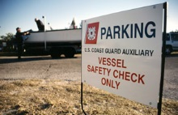
Auxiliary RBS Device
Vessel Safety Checks and Vessel Facility Inspections: Based: 1 point-per-VSC or facility inspection
RBS Program Visitation: 1 point-per-visit

Slide 19
Auxiliary RBS Device
Legislative Outreach:
Hours in Federal/State Legislative Outreach or Government Affairs work, Mission Codes 65A or 65B (1 point-per-hour limited to face-to-face contact hours, preparation or travel not included)
State RBS Outreach:
Hours recorded in meetings with a state BLA or state BLA staff, Mission Code 65C (1 point-per-hour limited to face-to-face contact hours, preparation or travel not included)

Slide 20
Recording Time
Reporting eligible activity for the RBS Device:
Mission Activity Report ANSC-7030
Vessel Examination Activity Report ANSC-7038
RBS Visitation Report ANSC-7046
All of the above

Slide 21
Recording Time
Reporting eligible activity for the RBS Device:
Mission Activity Report ANSC-7030
Vessel Examination Activity Report ANSC-7038
RBS Visitation Report ANSC-7046
All of the above (ANSC-7030, 7038 and 7046)

Slide 22
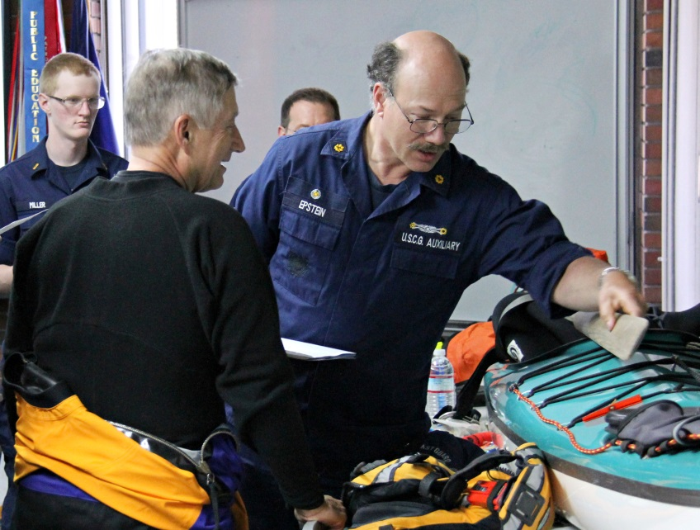
RBS Challenge
Work Together – create teams to focus on RBS
Develop a robust safety culture across all missions
Plan to succeed – develop and implement an annual plan to achieve RBS goals

